Slide 1
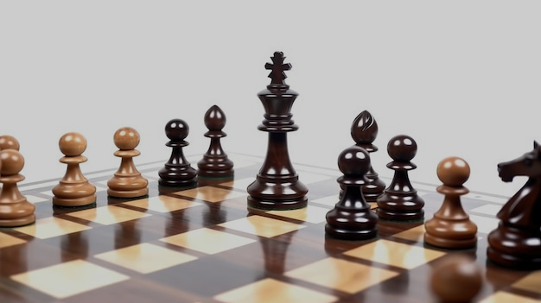

Implementa tion of a ranking system algorithm
230626717
Samuel Levy
Supervised by Marc Roth

Slide 2

Project Aims
Implement a web-application to handle the rankings of competitions
Provide an understanding of ranking algorithms used in games such as chess

Slide 3

What are ranking algorithms?
Elo ranking system
Introduced by Arpad E.Elo in 1960
Currently used in chess, go, football, and many more
Follows simple formula (R’=R+K(S−E))
with ranking R, score S and expected score E
Glicko ranking system
Introduced by Mark Glickman in 1995
Update to Elo
More precise because follows more complex parameters that depend on player’s history and deeper probabilities

Slide 4
Project Objectives
Implement a web application (using Django Framework)
Design a functional ranking algorithm based on the elo and glicko models
Implement two types of user to the app: player and admin
Design and implement a database to store useful information for the system

Slide 5

Supplementary Objective
If possible (despite time limitations) implement an experimental glicko algorithm variation allowing player history to have an bigger impact on the ranking evolution
Cette photo par Auteur inconnu est soumise à la licence CC BY-SA-NC

Slide 6

Programme of study
The programme: Computer Science Bsc
Web technology module for front-end
GUI Module for UI design
Database systems module for database
Probability and Matrices module for algorithm
Software engineering module for back-end

Slide 7
Why is this an engineering/computing problem?
Requires computing dynamic data in real-time
Involves theorical algorithmic but also practical implementation

Slide 8

Literature Review Findings
Ranking systems (specifically chess) were mainly researched by Arpad Elo and Mark Glickman
Thanks to research by Mark Glickman, some objectives were abandoned for simplicity
Two main ranking systems to implement: Elo (A.Elo, 1978) and Glicko (M.Glickman, 1995)

Slide 9
Preliminary requirements
Functional requirements:
Store user information, ranking, game history,…
Recording games and game outcomes
Store updated Elo and Glicko scores
Allow admin users to change user info and handle games
Non-functional requirements:
Support growth in number of user and data stored
Present ratings and match history to users in a clear and understandable way
Computations must be accurate

Slide 10

What is your proposed solution?
Implement a web application to handle both ranking systems
Elo will be put forward for lower ranks and glicko for higher ranks
The app will just allow to view profiles and rankings for normal users
Admin should be able to start/end games, handle profiles and record results

Slide 11

How will you evaluate your solution?
Test the functionalities of the web app:
Test the robustness of the rankings by testing different match settings
Testing user functionalities by creating several profiles
User testing to see if regular users can understand the UI
This method allows to test all the functionalities of the app and have some user feedback.

Slide 12
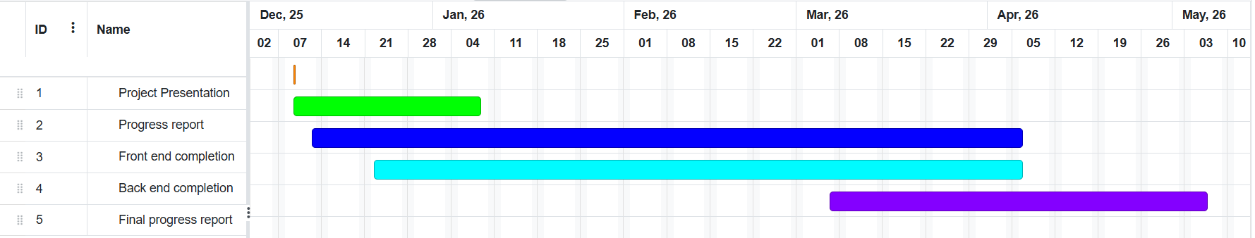
Project Planning
Achieved milestones:
Database design and code
Mathematical formula sheet
Litterary review
Planning:

Slide 13
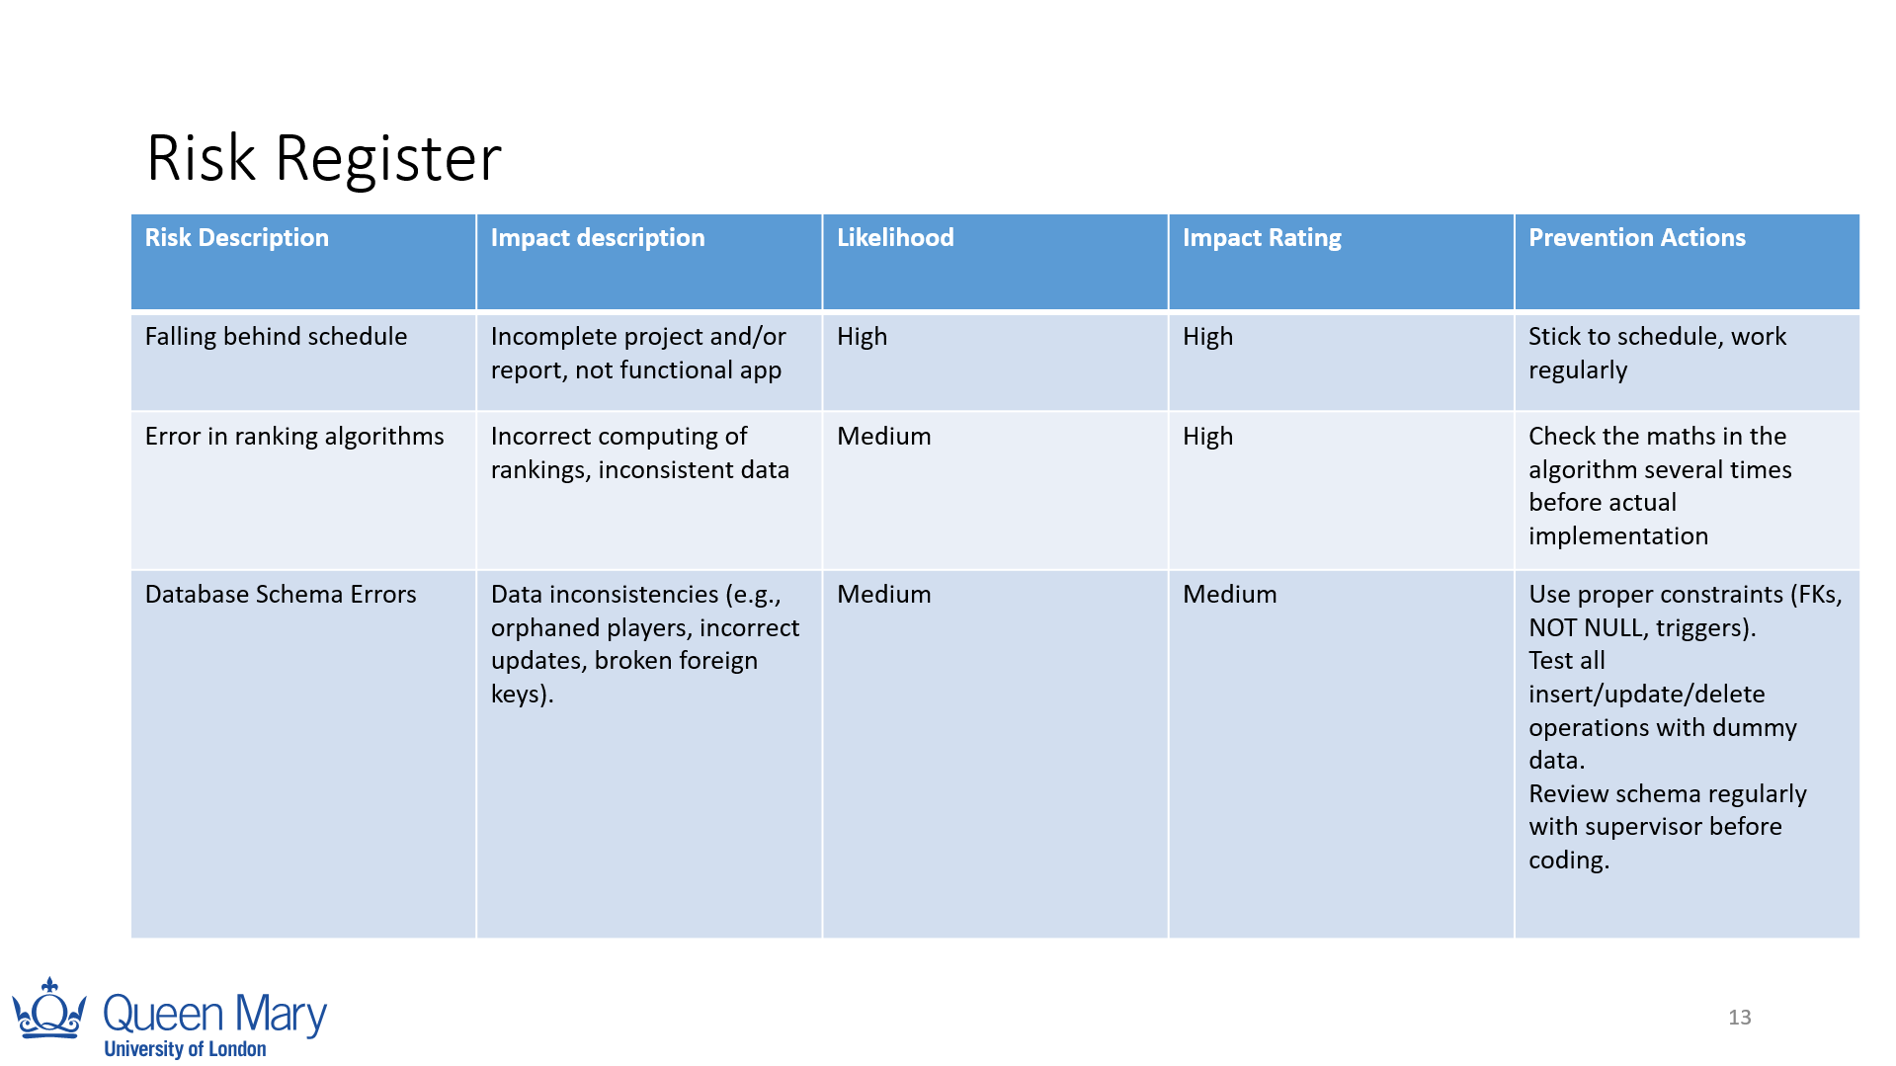
Risk Register
Risk Description | Impact description | Likelihood | Impact Rating | Prevention Actions
Falling behind schedule | Incomplete project and/or report, not functional app | High | High | Stick to schedule, work regularly
Error in ranking algorithms | Incorrect computing of rankings, inconsistent data | Medium | High | Check the maths in the algorithm several times before actual implementation
Database Schema Errors | Data inconsistencies (e.g., orphaned players, incorrect updates, broken foreign keys). | Medium | Medium | Use proper constraints (FKs, NOT NULL, triggers). Test all insert/update/delete operations with dummy data. Review schema regularly with supervisor before coding.

Slide 14
References
Arpad E. Elo. The Rating of Chess Players, Past and Present. Arco Publishing, 1978
Mark E. Glickman. The Glicko-2 Rating System. Online technical document, 2013. http://www.glicko.net/glicko/glicko2.pdf
Glickman, M. E. (2012). Example of the Glicko-2 system. Boston University, 28, 2012.
Glickman, M. E. (2001). Dynamic paired comparison models with stochastic variances. Journal of Applied Statistics, 28(6), 673–689.
Glickman, M. E. (1995). The glicko system. Boston University, 16(8), 9.

